Slide 1
ACCURATE VIBRATION & SPEED MEASUREMENT
ON ROTATING SHAFT USING MEMS & Iot Single wireless triaxle Sensor
James Hofmeister, Douglas Goodman, and Robert Wagoner
2016 Machine Failure Prevention Technology
March 23-26, 2016
Dayton, OH

Slide 2
Agenda
Introduction: RotoSense MEMS basics and block diagram
Shaft Mounted, Helicopter Pinion Gear (OH-58C): Test setup, diagram, results
Wheel-Mounted MEMS Sensor, RR-track Monitoring
  Adapted Shaft-mounted
  Experiment Description, National TT center
  Heavy Tonnage Test Track: Layout & Features
  MEMS Configuration and Test Setup
  Data Analysis
  Detected Features
Conclusion

Slide 3
Introduction
Industrial equipment, robotics, & gear boxes having rotating shafts – need for monitoring for Condition-based Maintenance (CBM)
  Typical solution: accelerometers, mounted on housing, vibration-based
  Limitations: cabling, slip-rings, multiplicity of sensors
Shaft-mounted, wireless, solution using micro-electro-mechanical system (MEMS)

Slide 4
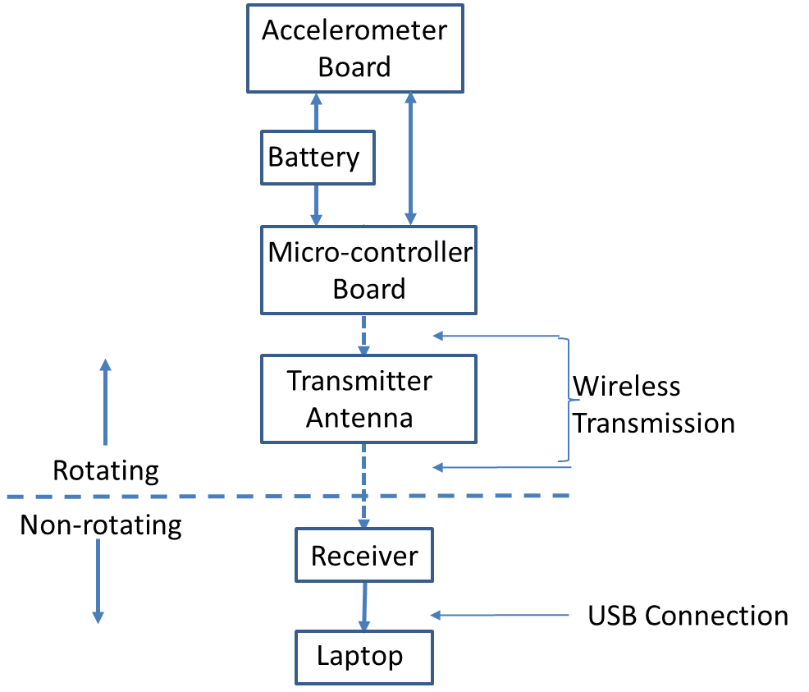
Introduction: Block Diagram – RotoSense MEMS

Slide 5
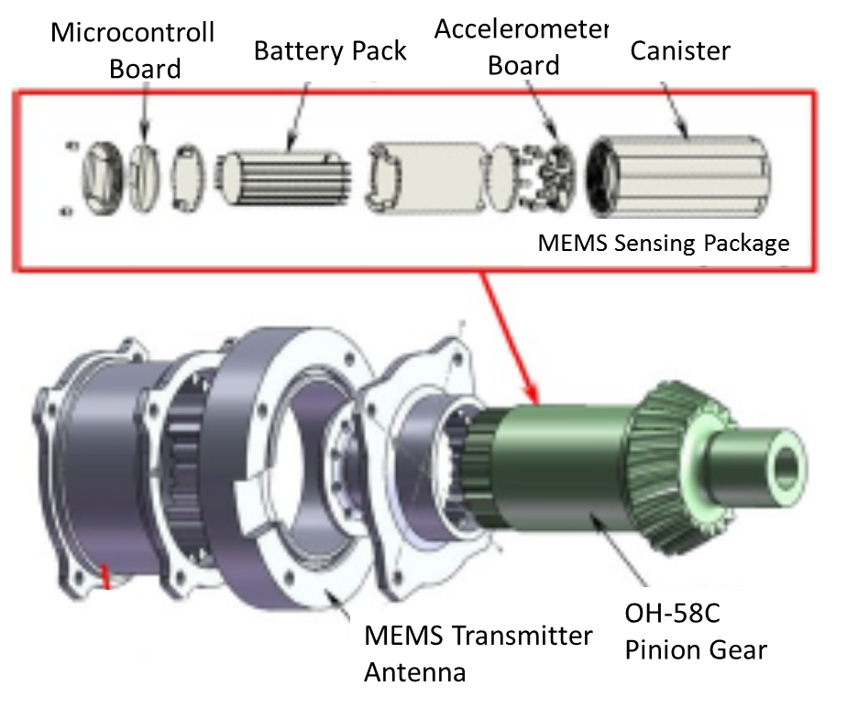
Shaft-mounted: OH58C Helicopter Transmission,
Pinion Gear
Spiral-bevel pinion gear
Pre-notched
Extended notch @ t=51.9 hr
Widened @ t=106 hours
4-stationary accelerometers and MEMS detected failure.

Slide 6
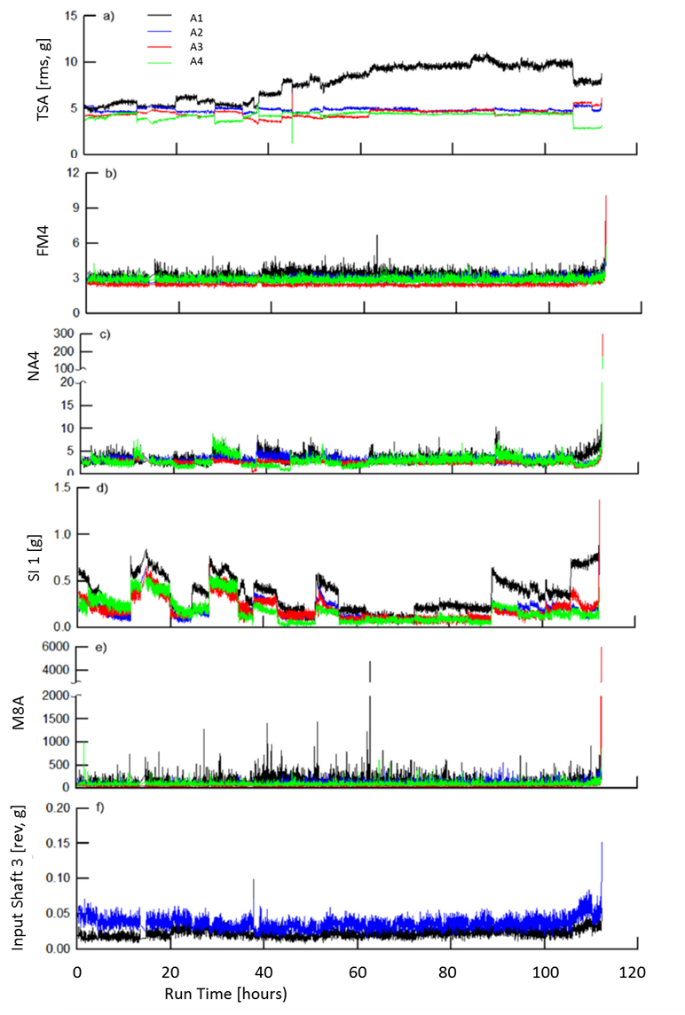
Shaft-mounted: Pinion Gear Test Results
A method of constructing a pseudo tach signal from periodic characteristic was developed to derive time-synchronous-average (TSA) signals.
Proved to be effective means to improve fault detection.
-----
NASA-funded 2015 project: TPOC, Dr. D.G. Lewicki

Slide 7
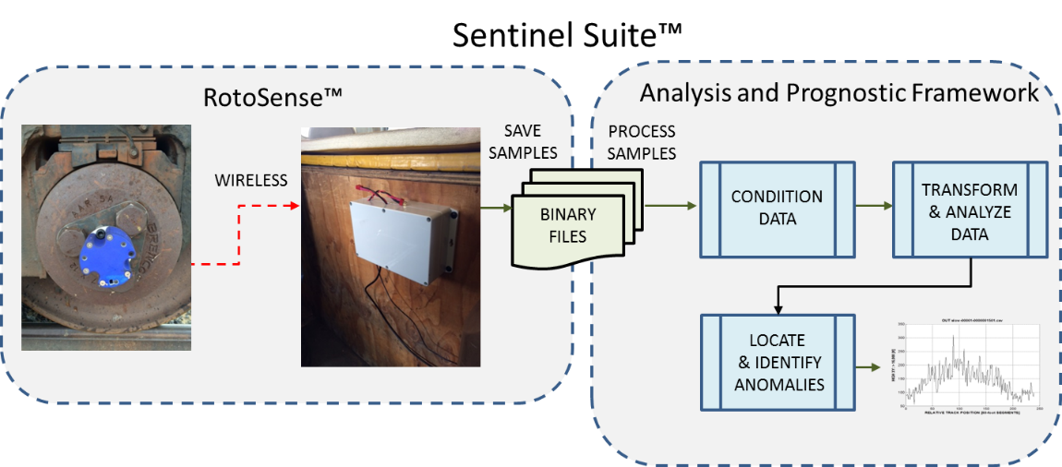
Wheel-mounted MEMS Sensor: Railroad Track
Monitor to locate & identify anomalies
Validate ability to provide a Track Anomaly Detection capability
(Despite damage to antenna and loss of GPS data)

Slide 8
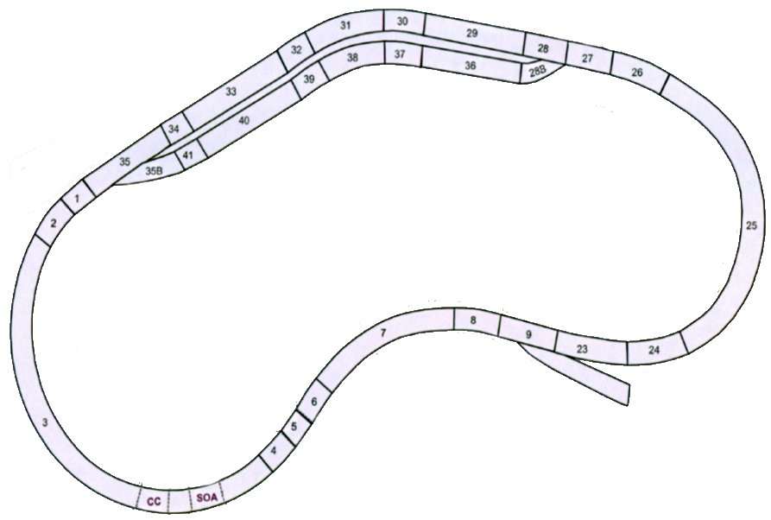
Experiment Description: Test Track in Colorado
Test train
Three locomotives
110 freight cars
~ 6,700 feet in length
Heavy Tonnage Loop Test Track (HTL TT)
2.7 miles long
“features” to test track-component reliability

Slide 9
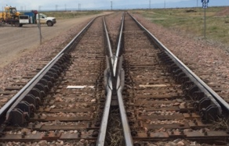
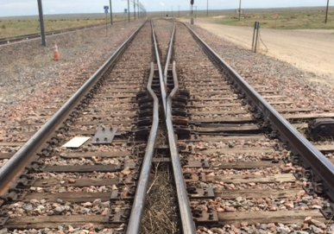
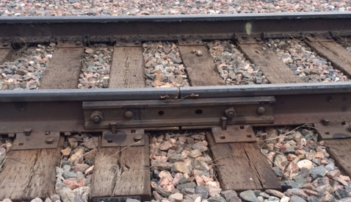
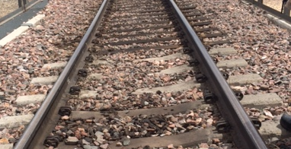
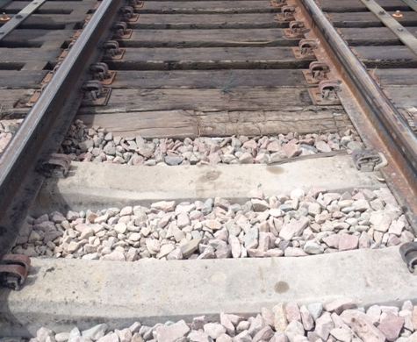
Test Track: Features
Turn out and frog
Turn out and frog
Steel bridge
Concrete bridges
Concrete bridges & crib ties

Slide 10
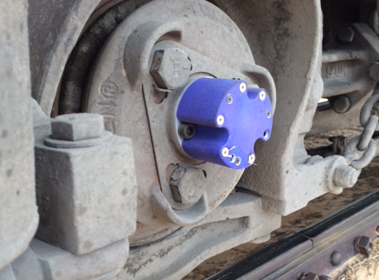
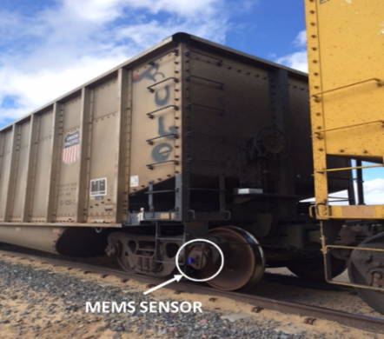
MEMS Configuration & Test Setup
MEMS: Three axis, 57mV/g
Train: auto-controlled
15 laps/hour: 40.5 miles/hour, 4-minutes/lap
38,640 samples per lap
Four test runs: May 11 – May 14 of 2015
Analyzed data collected May 14 (2000 to 0632)
10 hours, 32 minutes (932 minutes); ; 132 laps @ speed
Sampling rate: 161 Hz
Over 4 million sets of 6-bytes of data

Slide 11
Summary: 05/14/2015 Test Run

Slide 12
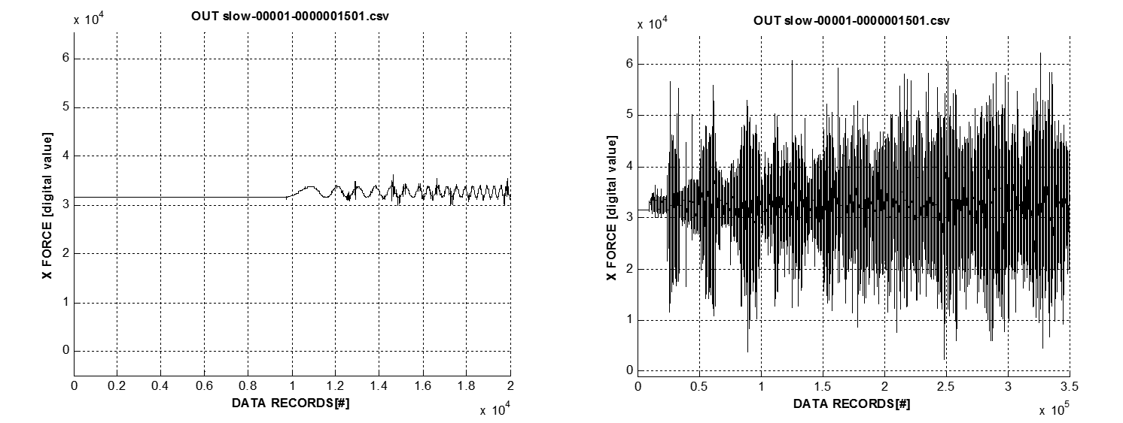
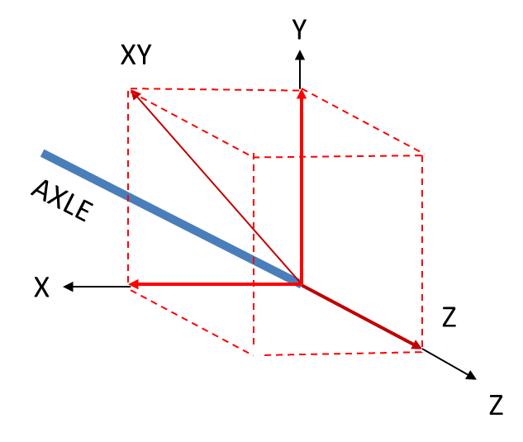
Data Analysis
First step: synchronize data to movement of the train
Transform x-, y-, and z-direction data to vectors:
  XY (vertical plane) and Z vectors (horizontal plane)
Noise mitigation
Group and bin data into 240 sections representing the track

Slide 13
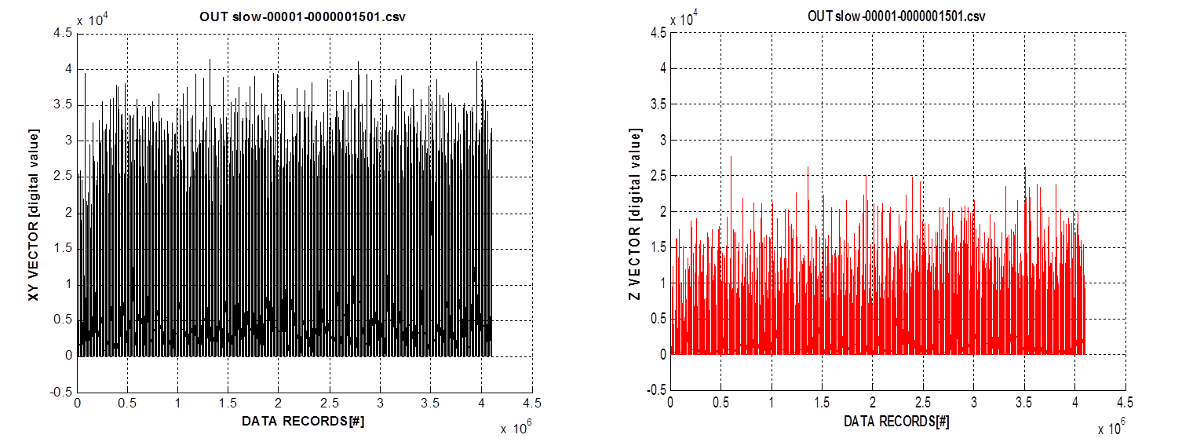
Data Analysis: XY and Z Vectors
Vector data prior to noise mitigation and binning
Start data file # 1501 (sample number 237,121)
161 samples/s; 240 s/lap; 38,640 samples/lap
Process 99 laps (3,825,360 6-byte samples)
Selected start point is section 1

Slide 14
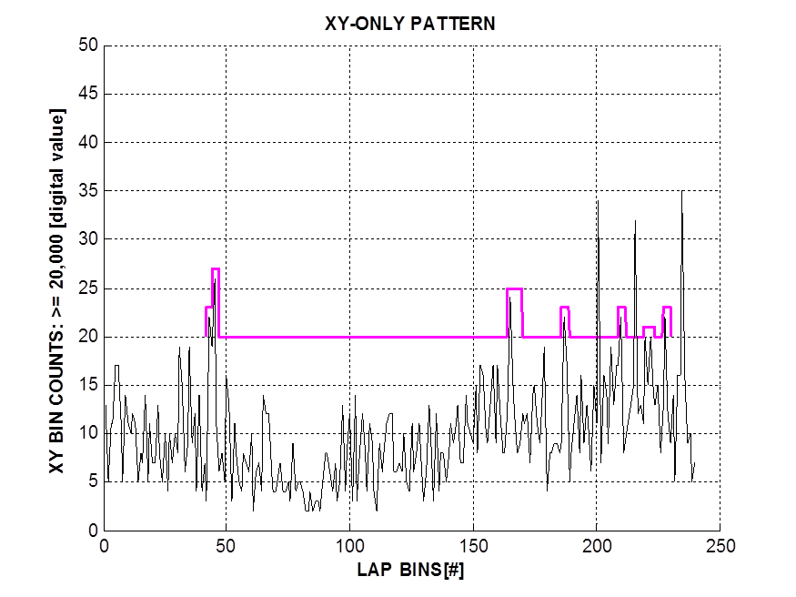
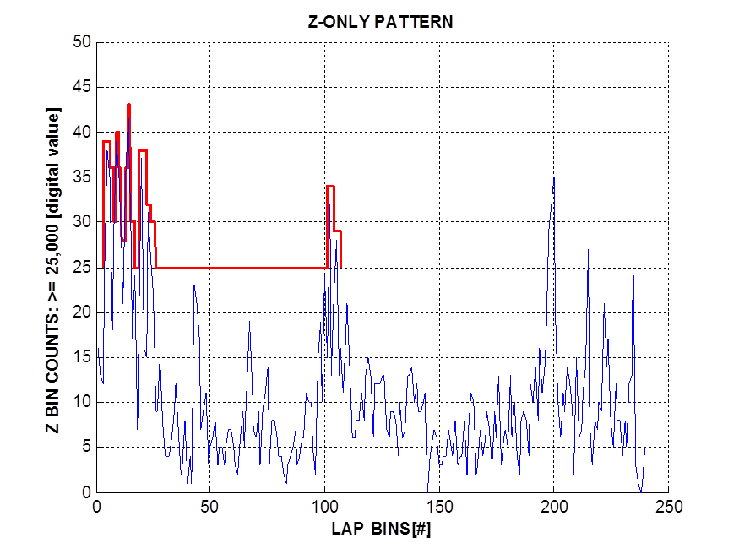
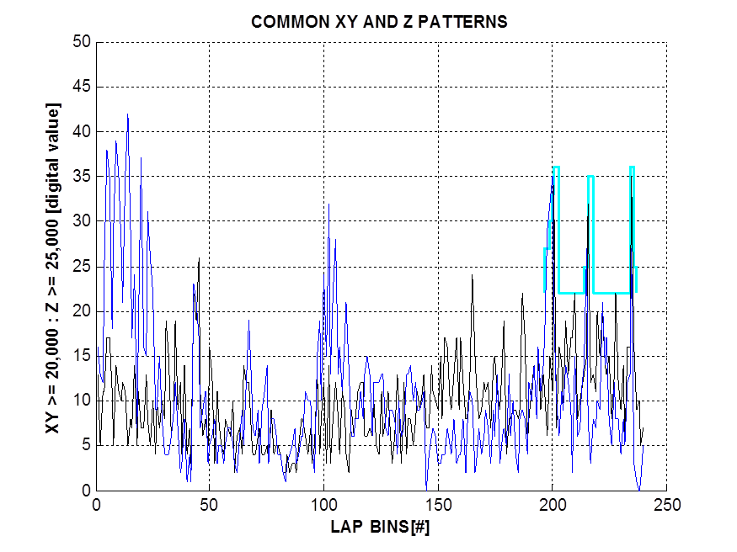
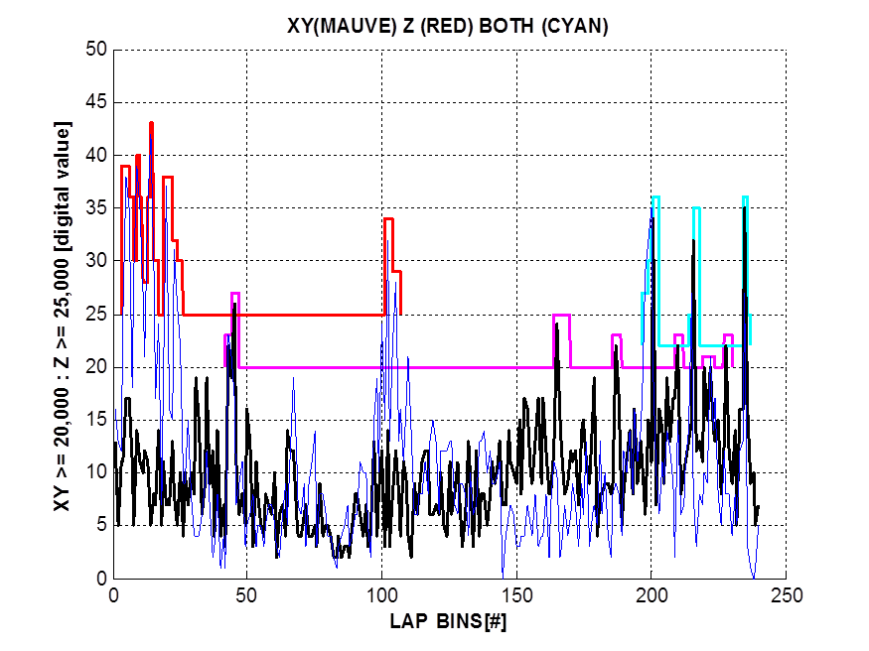
Data Analysis: Patterns

Slide 15
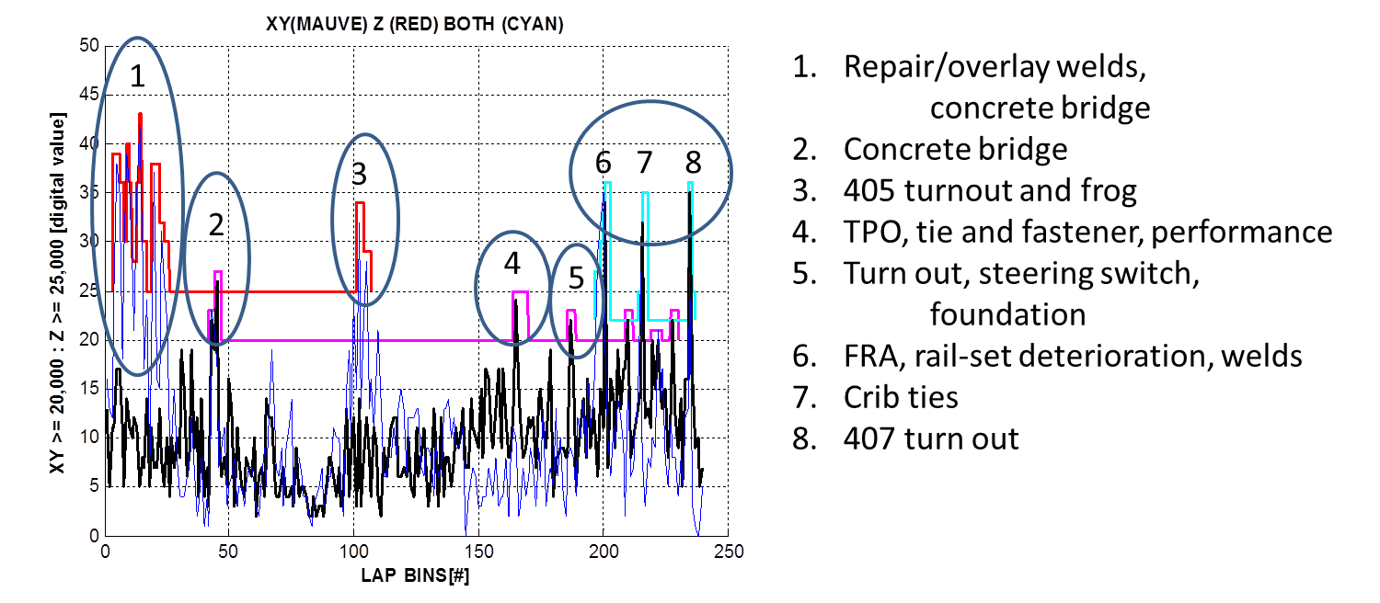
Data Analysis: Correlation of Results to Features
All seven of the track features evaluated as “detectable” were detected
One of the two concrete features detected as “maybe” was detected
(concrete bridge followed by crib ties – slide 9)
None of the features evaluated as “not detectable” were detected

Slide 16
Data Analysis: Track Description & Feature Detection

Slide 17
Conclusion
Two applications of tri-axle MEMS sensor
Helicopter gear box
Detected gear-tooth fault of a spiral-bevel pinion gear
Did so better than four stationary, housing-mounted accelerometers
Condition monitoring of a railroad track
Sensors did not fail electronically or physically
(TT Center personnel informed us that all other such tests failed one or both)
All seven features “evaluated as detectable” were correctly detected
One of the two features “evaluated as maybe” was detected
All of the features “evaluated as not detectable” were correctly not detected
  Despite not having GPS data to synchronize data to the track locations

Slide 18
THANK YOU!!

